Slide 1
Module 4 - Amazon Aurora

Slide 2

Objectives
Compatibility with Database Engines
Storage Auto-Scaling
Low latency read replicas
Auto Fail Over Grouping
Backup and Point-in-time Recovery
HA Across Availability Zones
Aurora DB for heavy write traffic

Slide 3

What is Amazon Aurora?
Amazon Aurora (Aurora) is a fully managed relational database engine that's compatible with MySQL and PostgreSQL. You already know how MySQL and PostgreSQL combine the speed and reliability of high-end commercial databases with the simplicity and cost-effectiveness of open-source databases.

Slide 4
Amazon Aurora DB Clusters
There are two types of DB instances that make up an Aurora DB cluster
Primary DB instance – Supports read and write operations, and performs all of the data modifications to the cluster volume. Each Aurora DB cluster has one primary DB instance.
Aurora Replica – Connects to the same storage volume as the primary DB instance and supports only read operations. Each Aurora DB cluster can have up to 15 Aurora Replicas in addition to the primary DB instance. Maintain high availability by locating Aurora Replicas in separate Availability Zones. Aurora automatically fails over to an Aurora Replica in case the primary DB instance becomes unavailable.

Slide 5
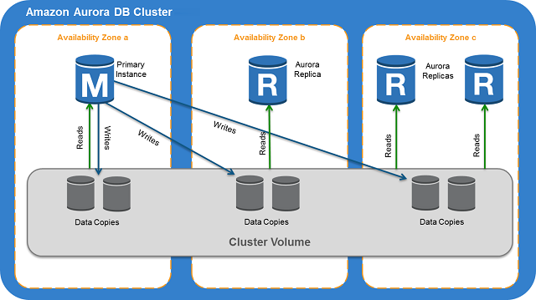
Relationship between the Cluster Volume and Primary DB Instance

Slide 6
Amazon Aurora Endpoints
Cluster endpoint:
A cluster endpoint is an endpoint for an Aurora DB cluster that connects to the current primary DB instance for that DB cluster. Each Aurora DB cluster has a cluster endpoint and one primary DB instance.
Reader endpoint:
A reader endpoint is an endpoint for an Aurora DB cluster that connects to one of the available Aurora Replicas for that DB cluster. Each Aurora DB cluster has a reader endpoint.
Instance endpoint:
An instance endpoint is an endpoint for a DB instance in an Aurora DB cluster that connects to that specific DB instance. Each DB instance in a DB cluster, regardless of instance type, has its own unique instance endpoint.

Slide 7
Amazon Aurora Storage and Reliability
Amazon Aurora Storage
Aurora data is stored in the cluster volume, which is a single, virtual volume that utilizes solid state disk (SSD) drives. A cluster volume consists of copies of the data across multiple Availability Zones in a single region.
Aurora cluster volumes automatically grow as the amount of data in your database increases. An Aurora cluster volume can grow to a maximum size of 64 terabytes (TB).

Slide 8
Amazon Aurora Reliability
Aurora is designed to be reliable, durable, and fault tolerant. You can architect your Aurora DB cluster to improve availability by doing things such as adding Aurora Replicas and placing them in different Availability Zones, and also Aurora includes several automatic features that make it a reliable database solution.
It uses following features for reliability:
Storage Auto-Repair
Survivable Cache Warming
Crash Recovery

Slide 9
Amazon Aurora Security
IAM Access Control
VPC Implementation
Firewall
Authentication via Login Credentials

Slide 10
Replication with Aurora MySQL
In addition to Aurora Replicas, you have the following options for replication with Aurora MySQL:
Two Aurora MySQL DB clusters in different AWS Regions, by creating an Aurora Read Replica of an Aurora MySQL DB cluster in a different AWS Region.
Two Aurora MySQL DB clusters in the same region, by using MySQL binary log (binlog) replication.
An Amazon RDS MySQL DB instance as the master and an Aurora MySQL DB cluster, by creating an Aurora Read Replica of an Amazon RDS MySQL DB instance. Typically, this approach is used for migration to Aurora MySQL, rather than for ongoing replication.

Slide 11
Replication with Aurora PostgreSQL
In addition to Aurora Replicas, you can set up replication between an Amazon RDS PostgreSQL DB instance as the master and an Aurora PostgreSQL DB cluster. You do so by creating an Aurora Read Replica of an Amazon RDS PostgreSQL DB instance.

Slide 12
Demo – Creating Infrastructure for Aurora

Slide 13
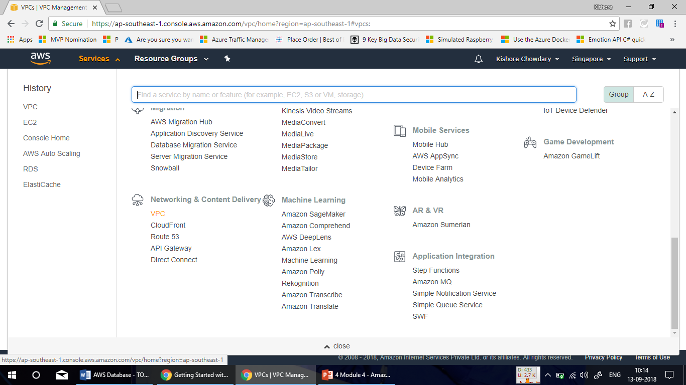

Slide 14
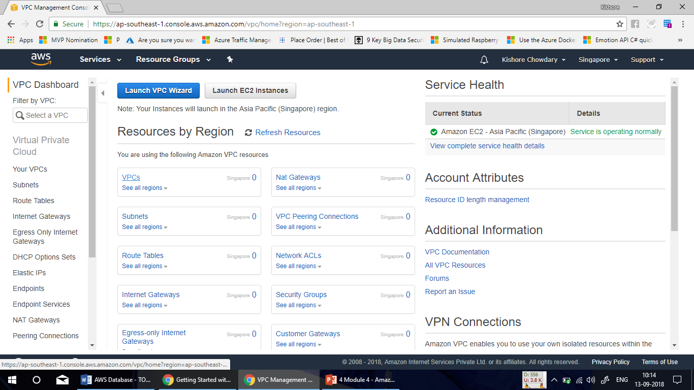

Slide 15
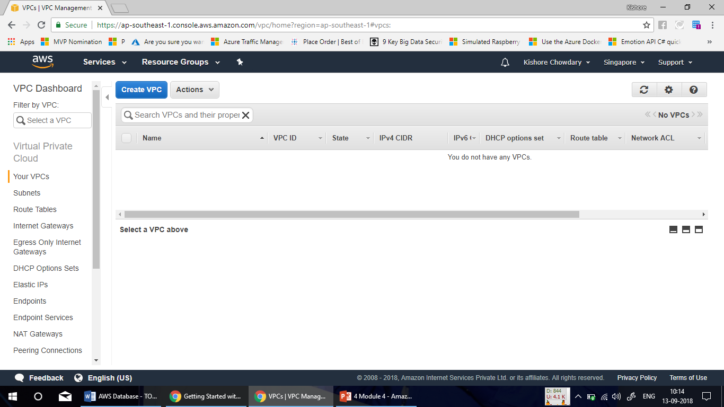

Slide 16
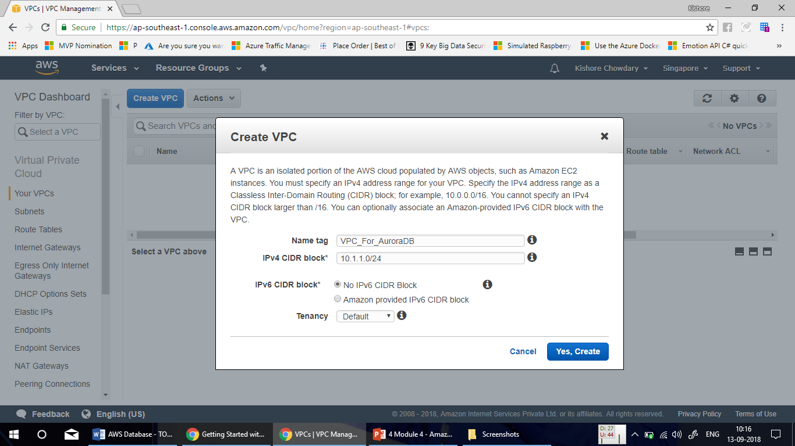

Slide 17
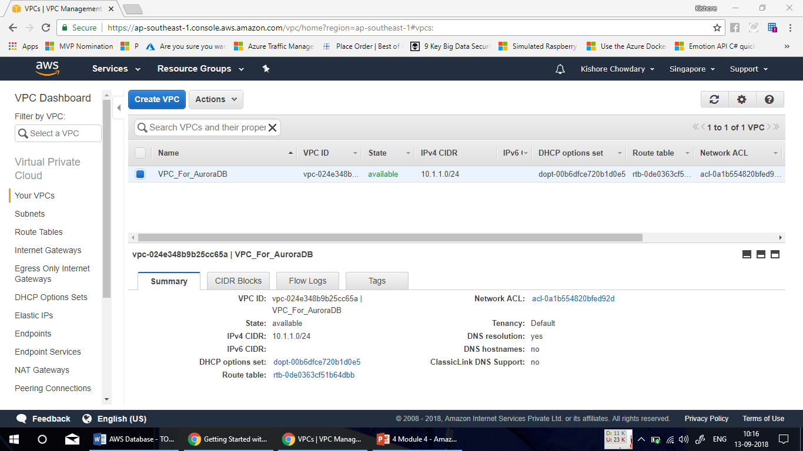

Slide 18
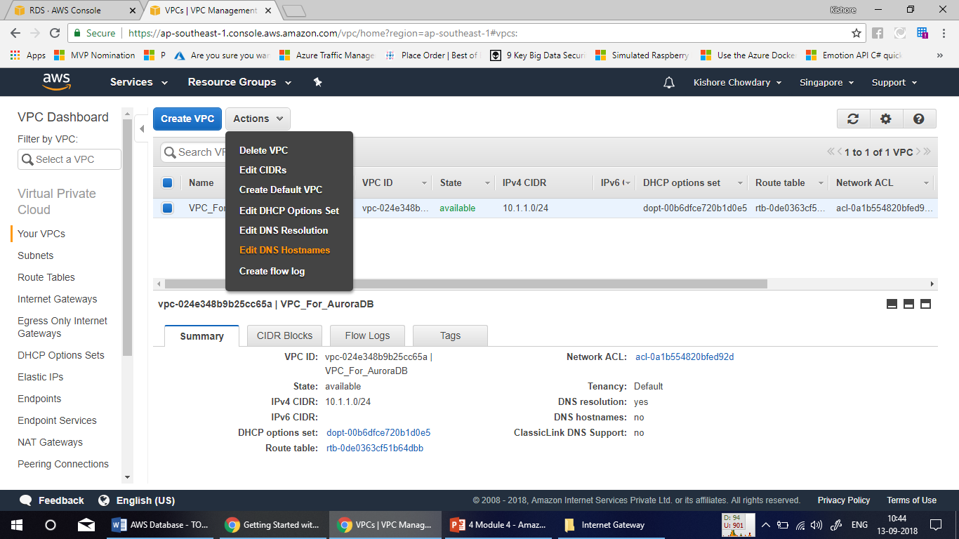

Slide 19
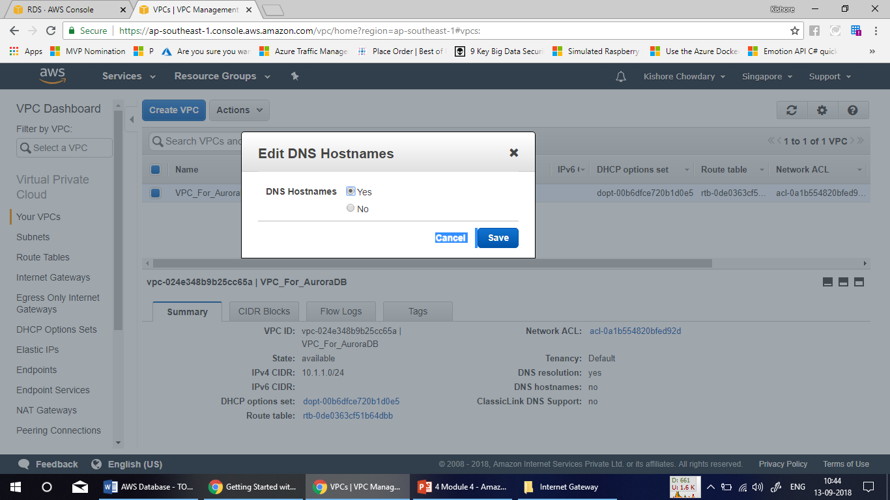

Slide 20
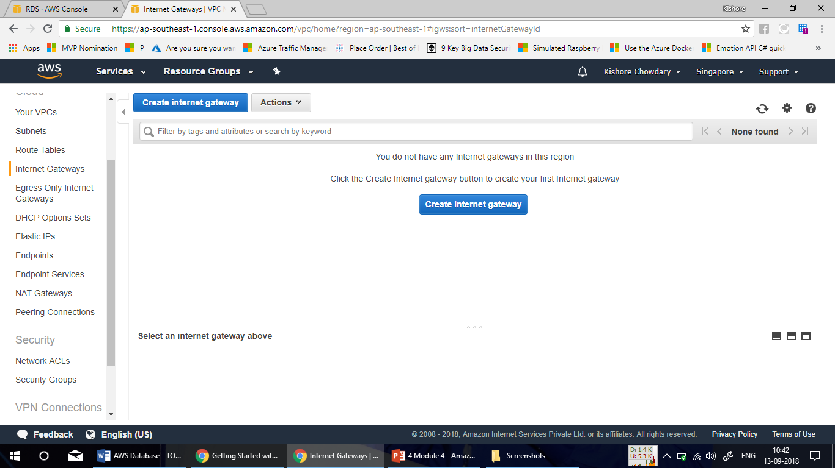

Slide 21
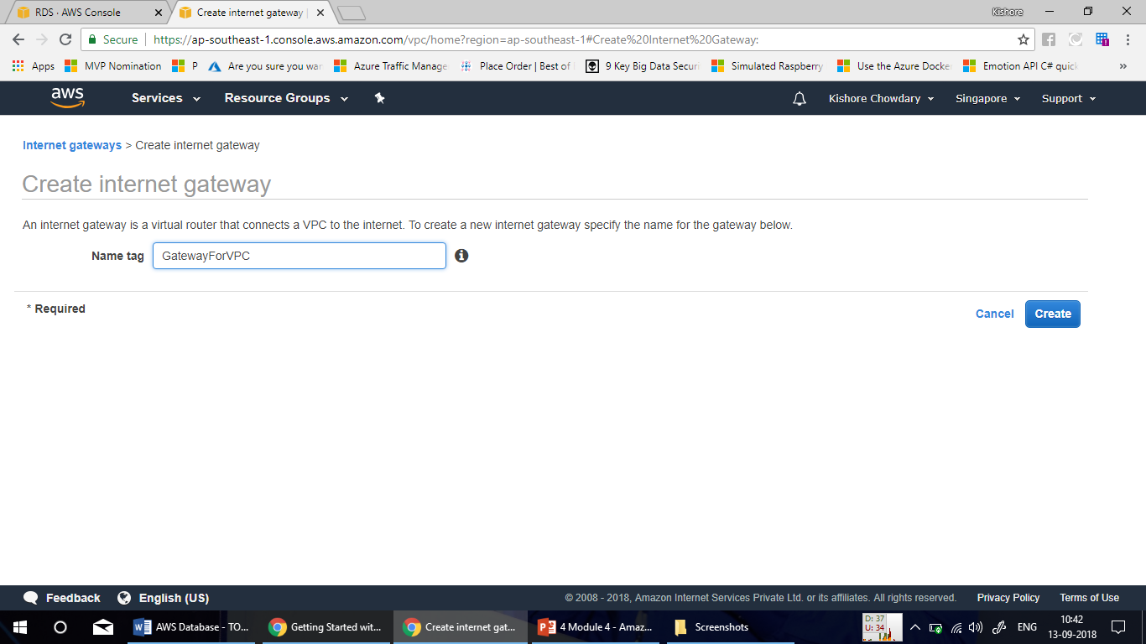

Slide 22
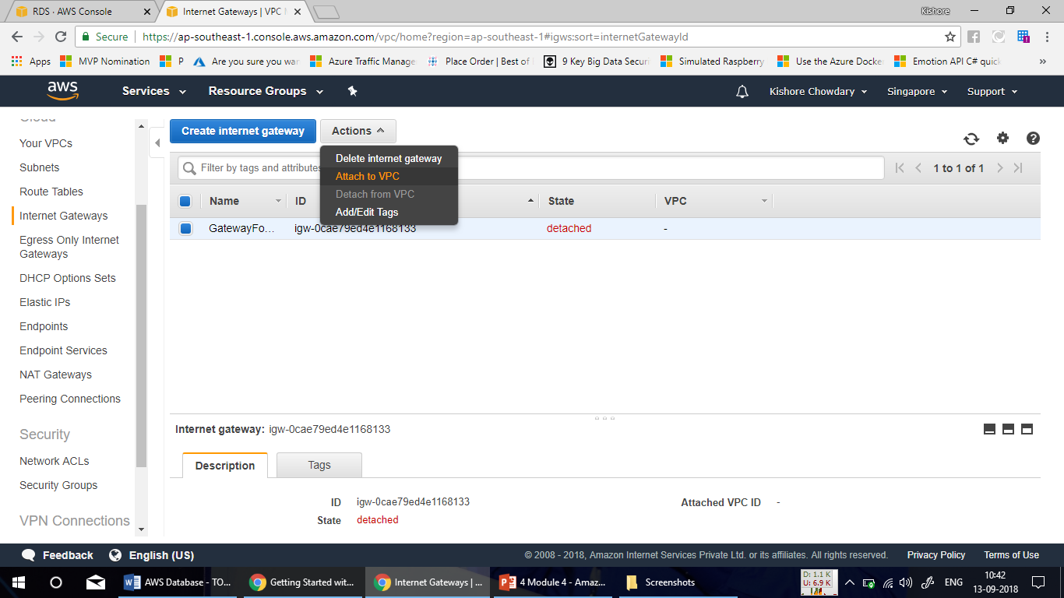

Slide 23
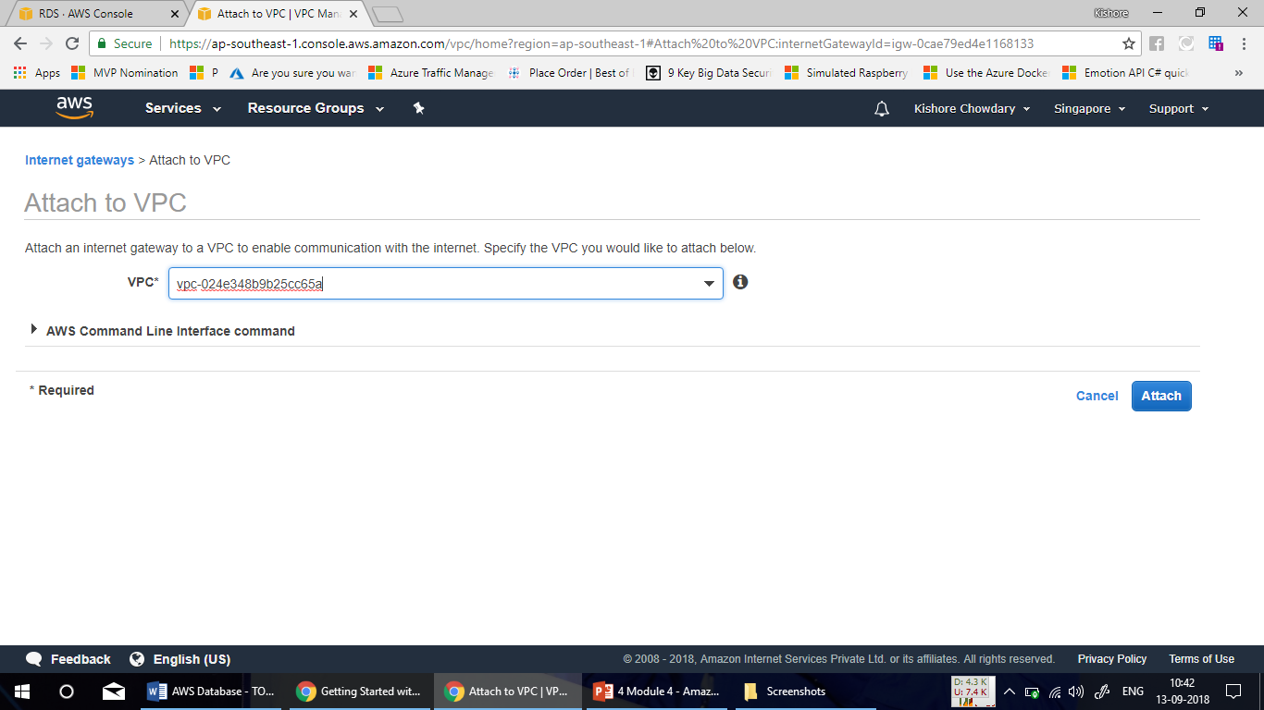

Slide 24
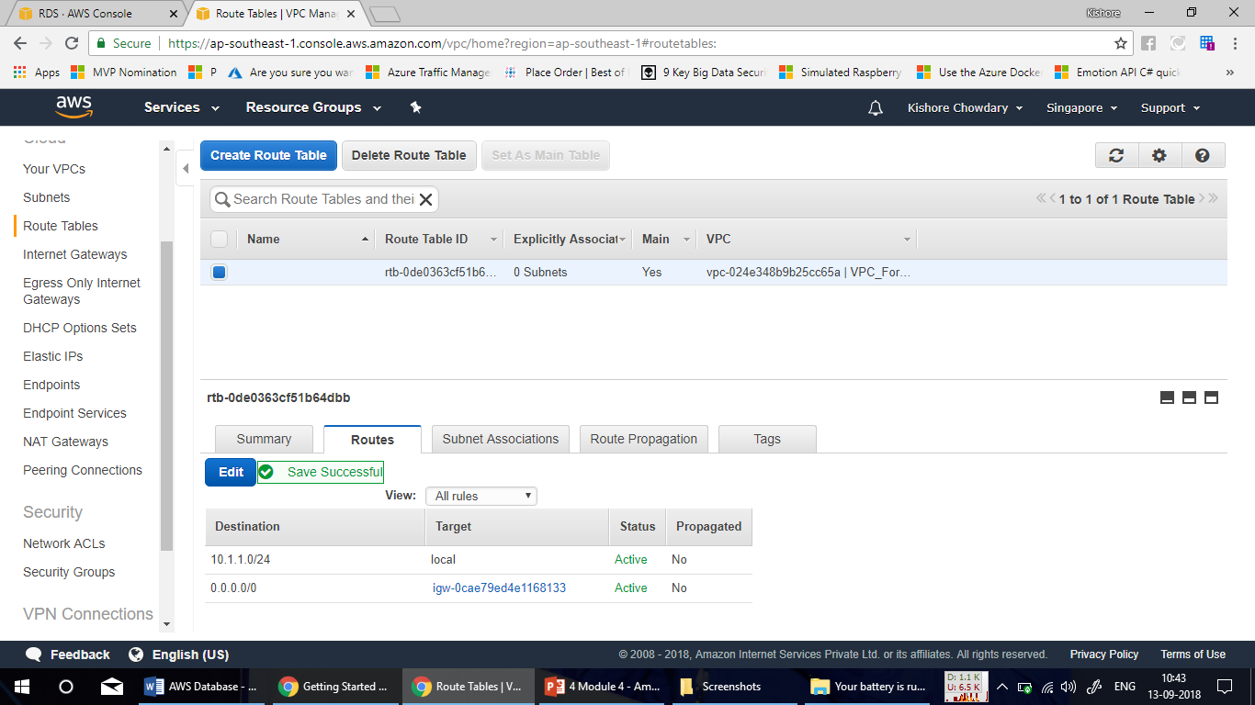

Slide 25
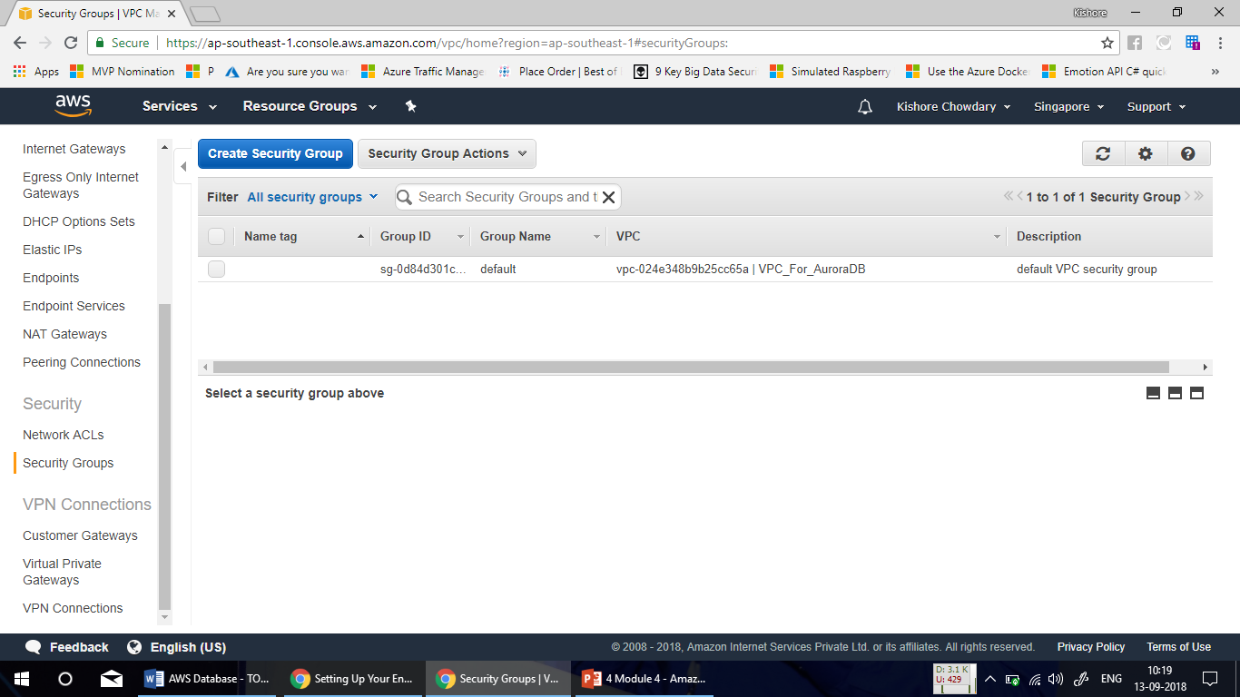

Slide 26
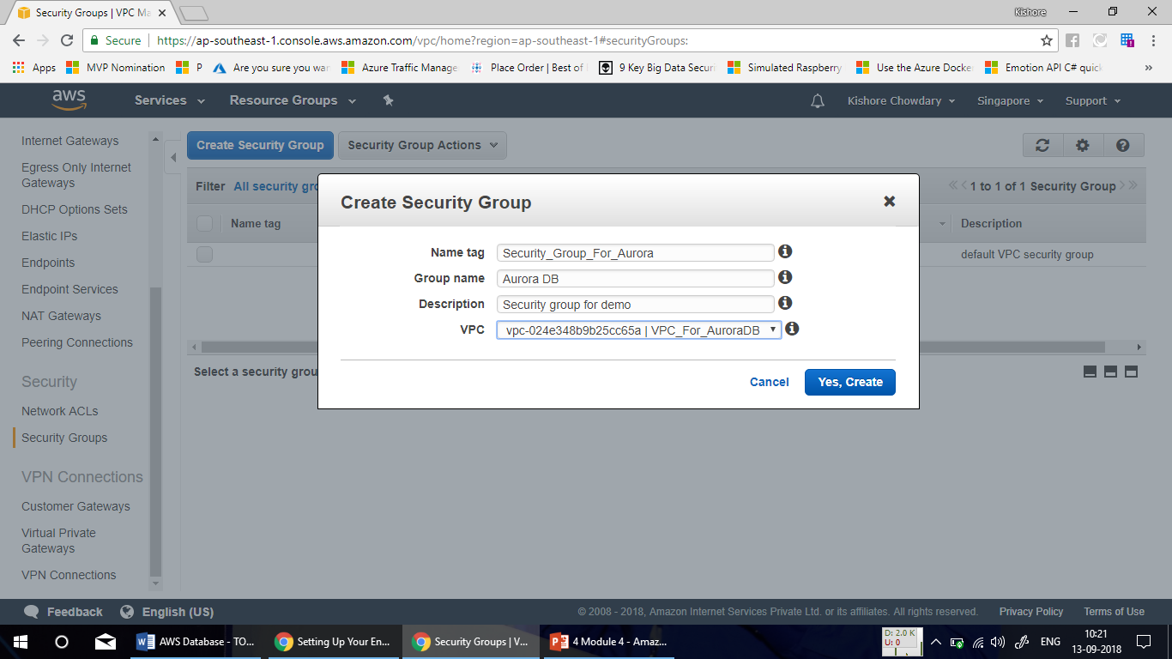

Slide 27
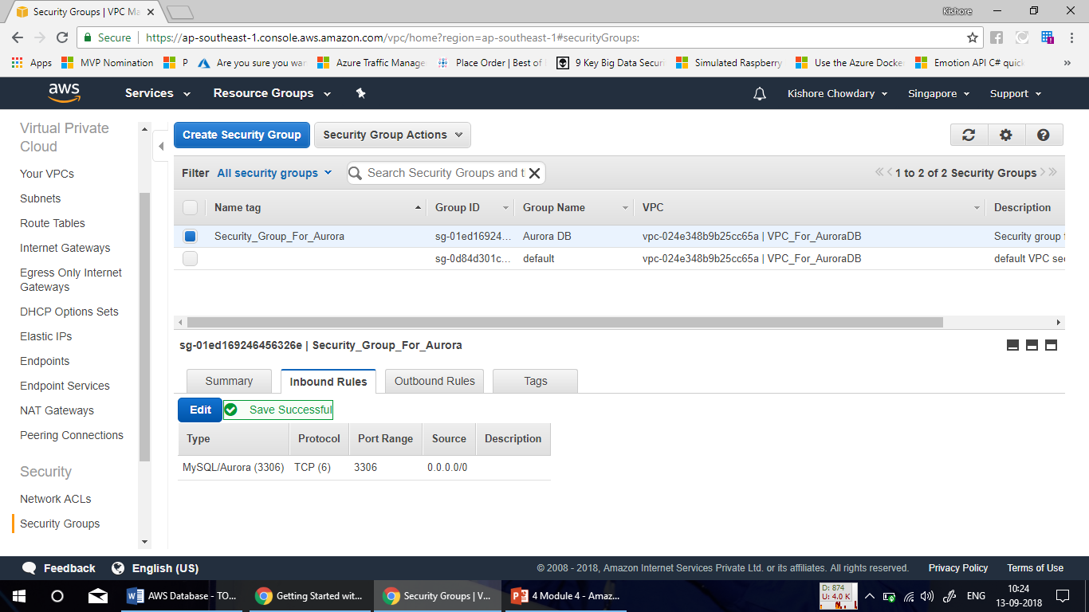

Slide 28
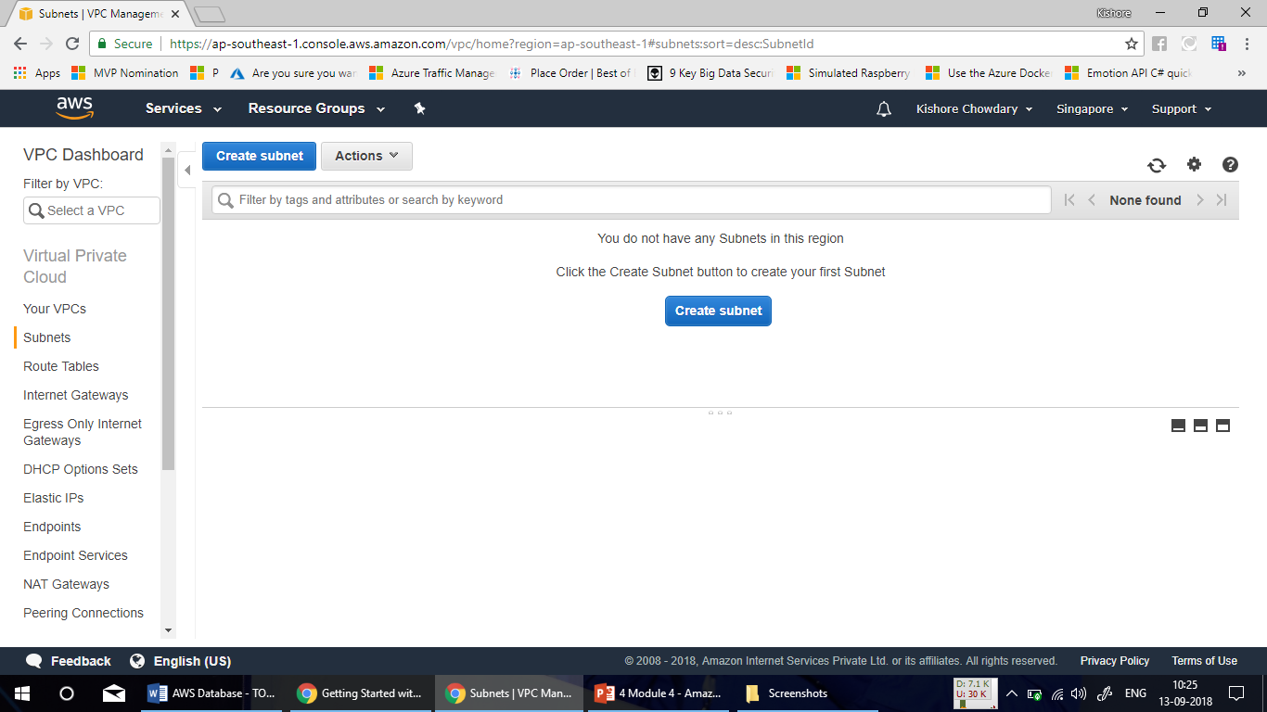

Slide 29
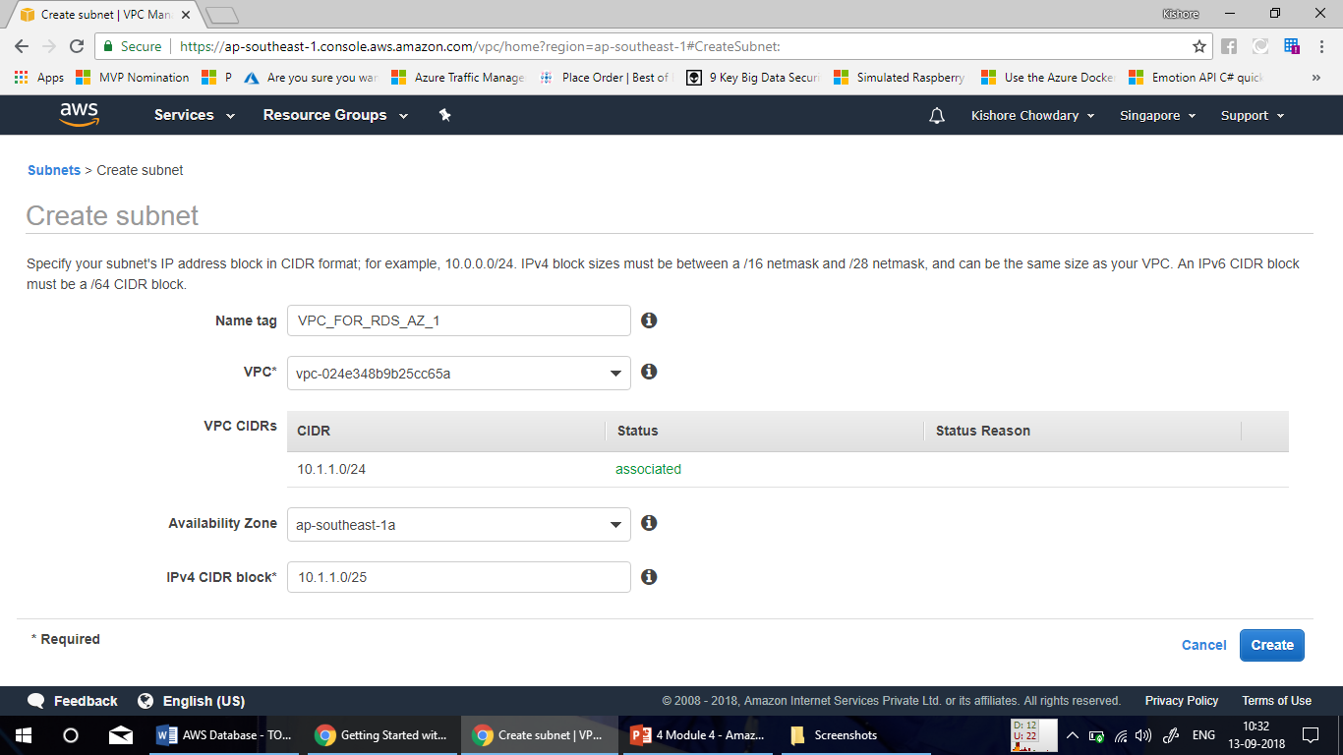

Slide 30
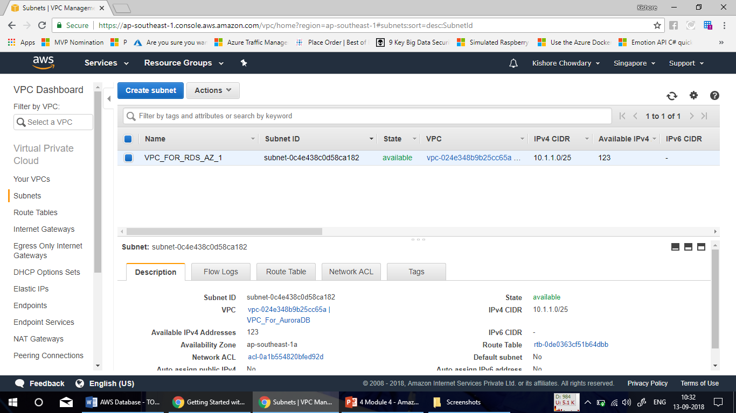

Slide 31
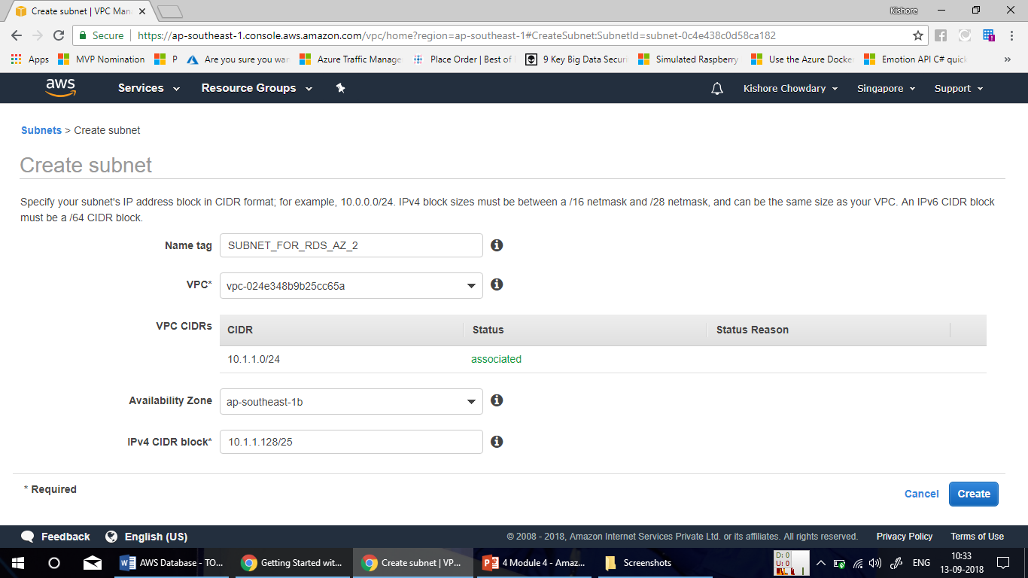

Slide 32
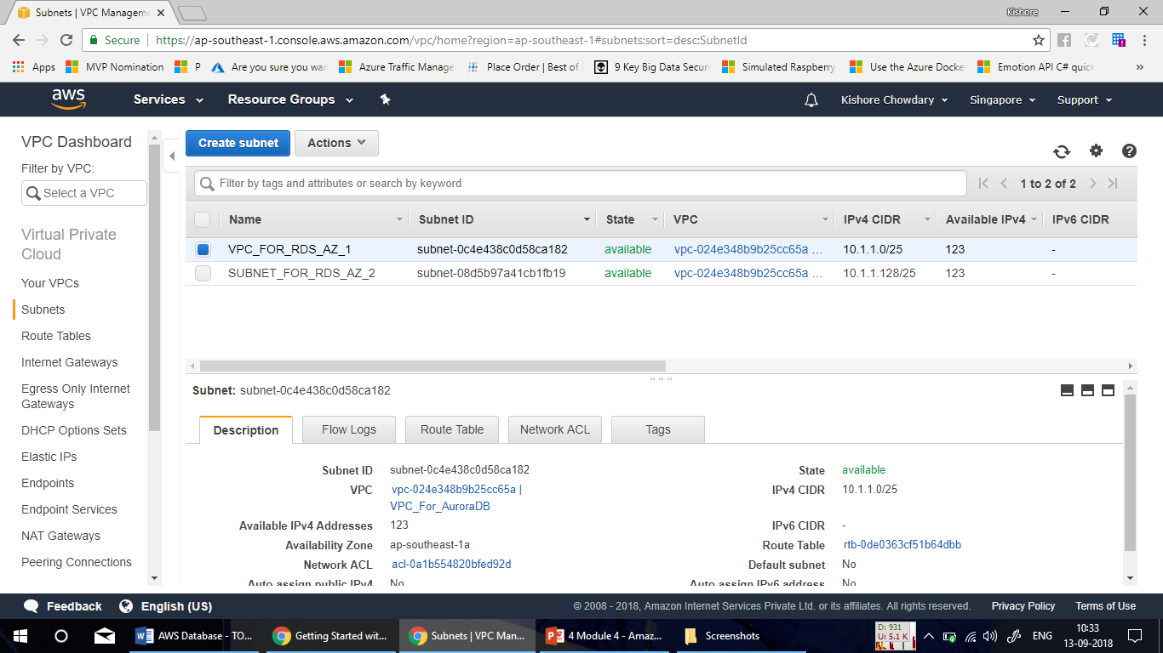

Slide 33
Demo – Creating Amazon Aurora Db Cluster

Slide 34
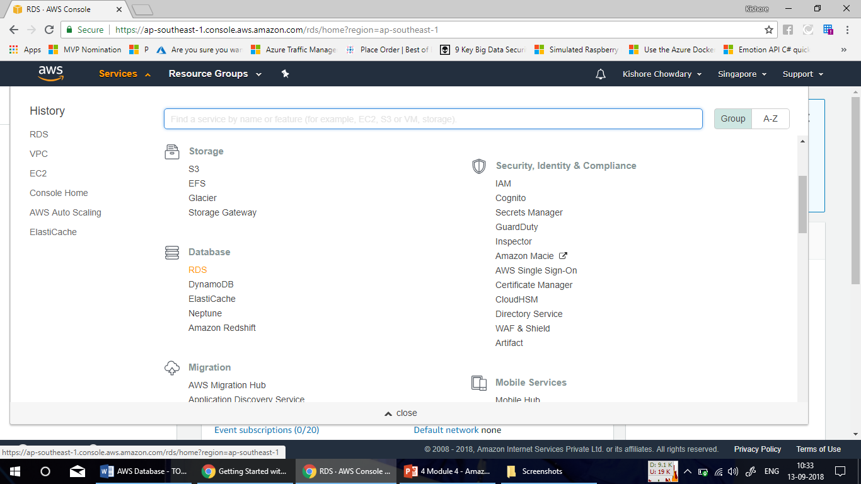

Slide 35
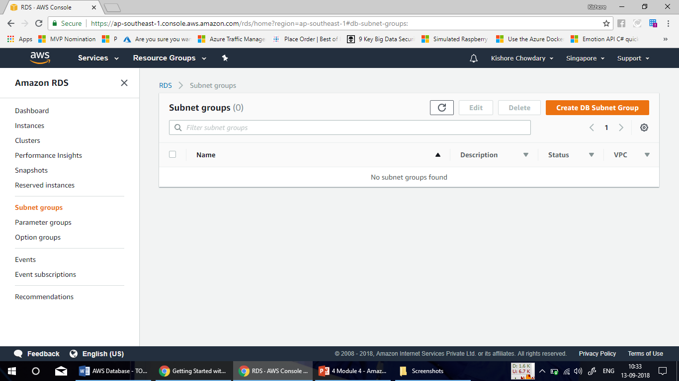

Slide 36
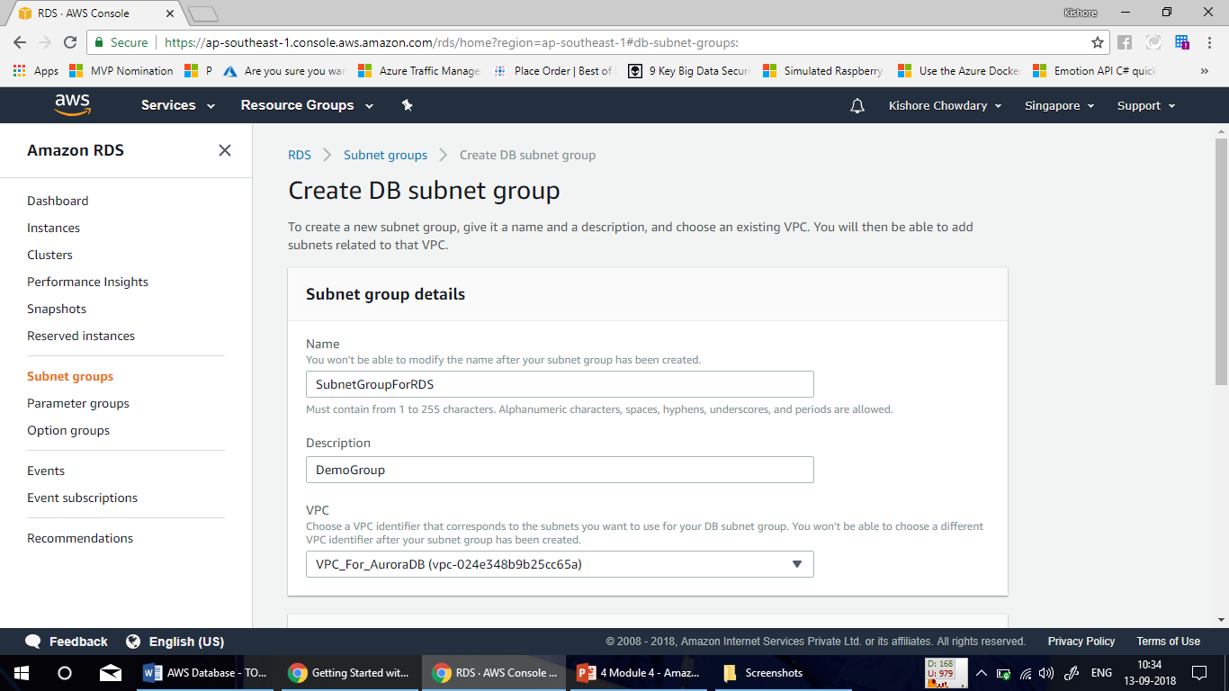

Slide 37
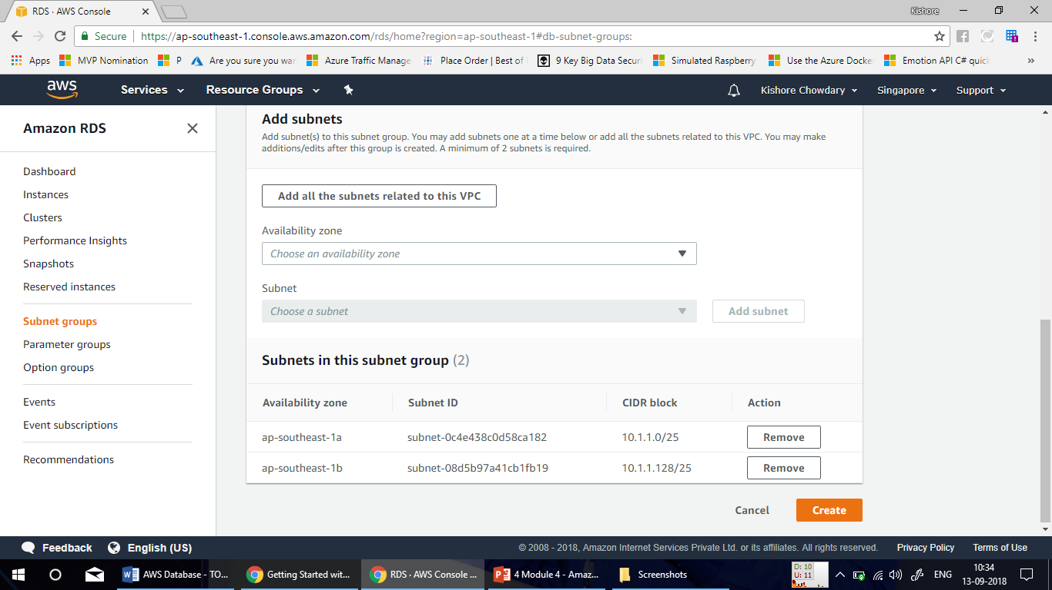

Slide 38
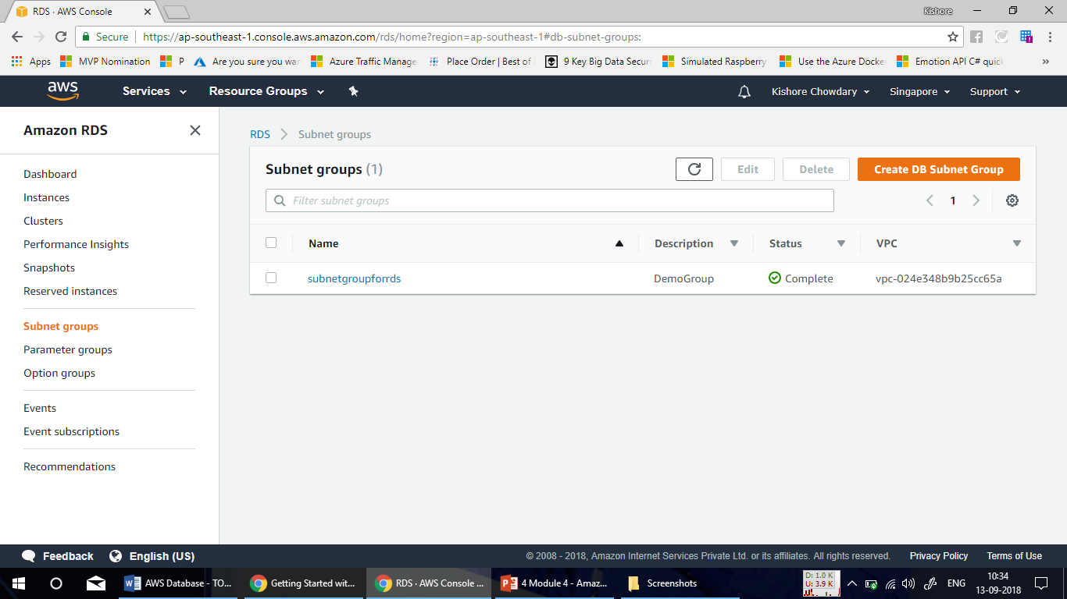

Slide 39
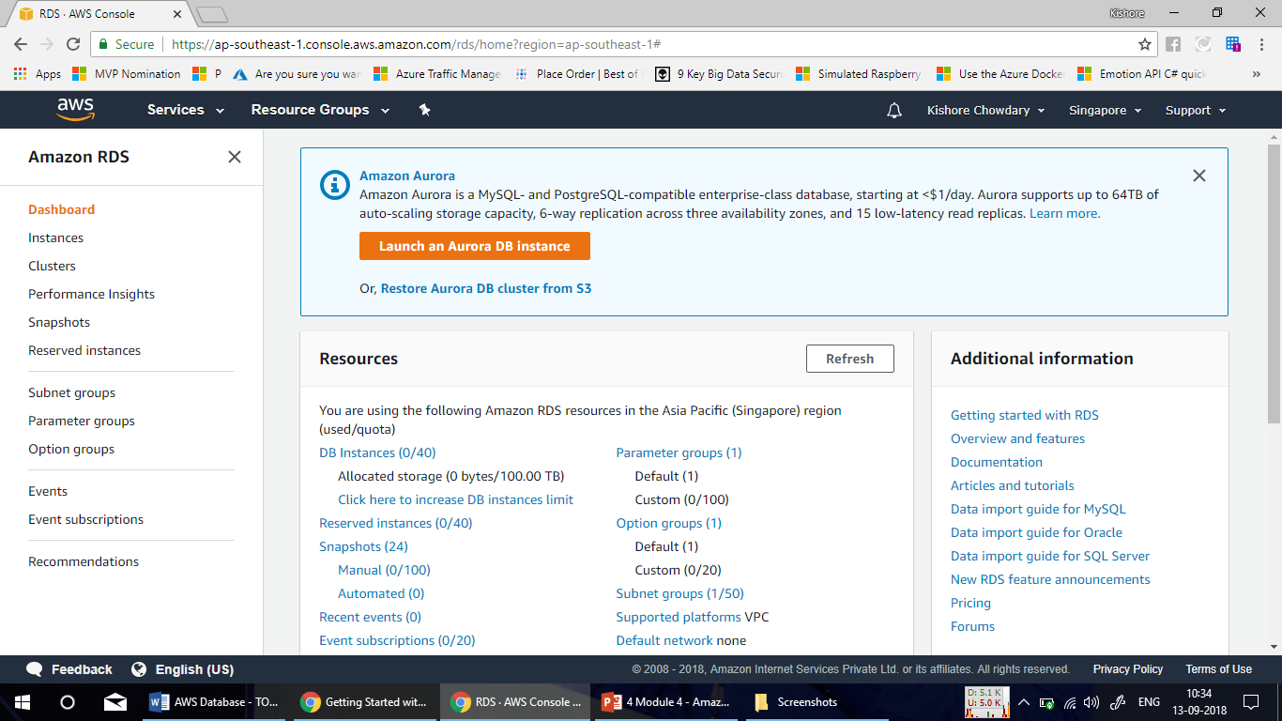

Slide 40
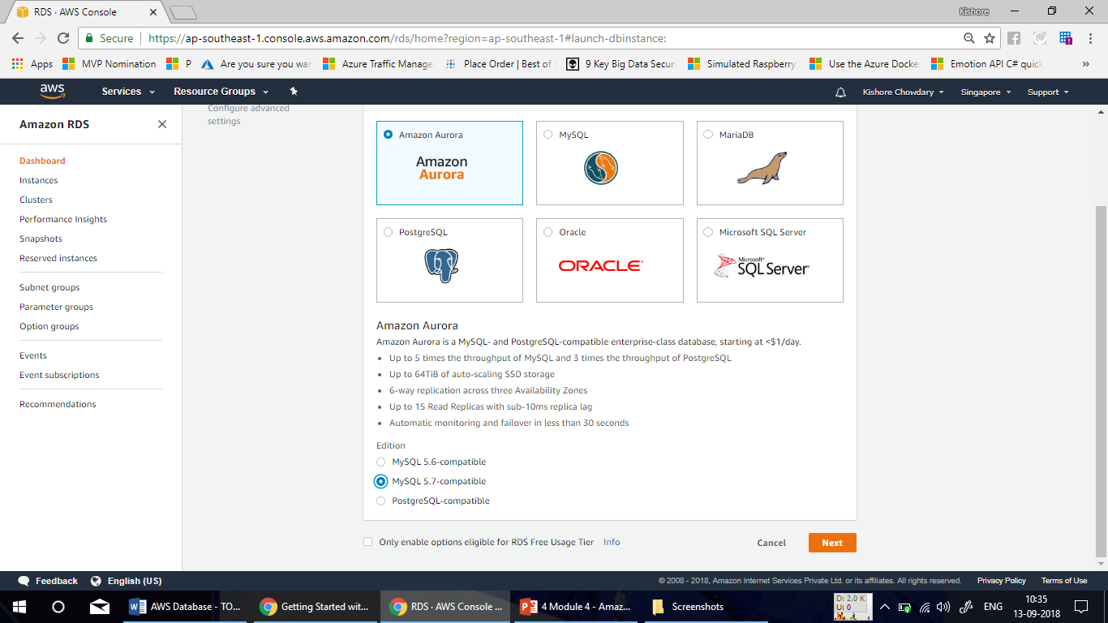

Slide 41
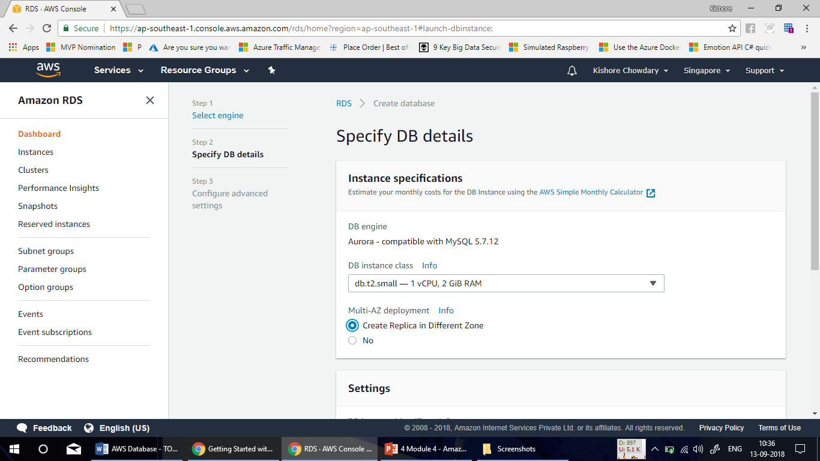

Slide 42
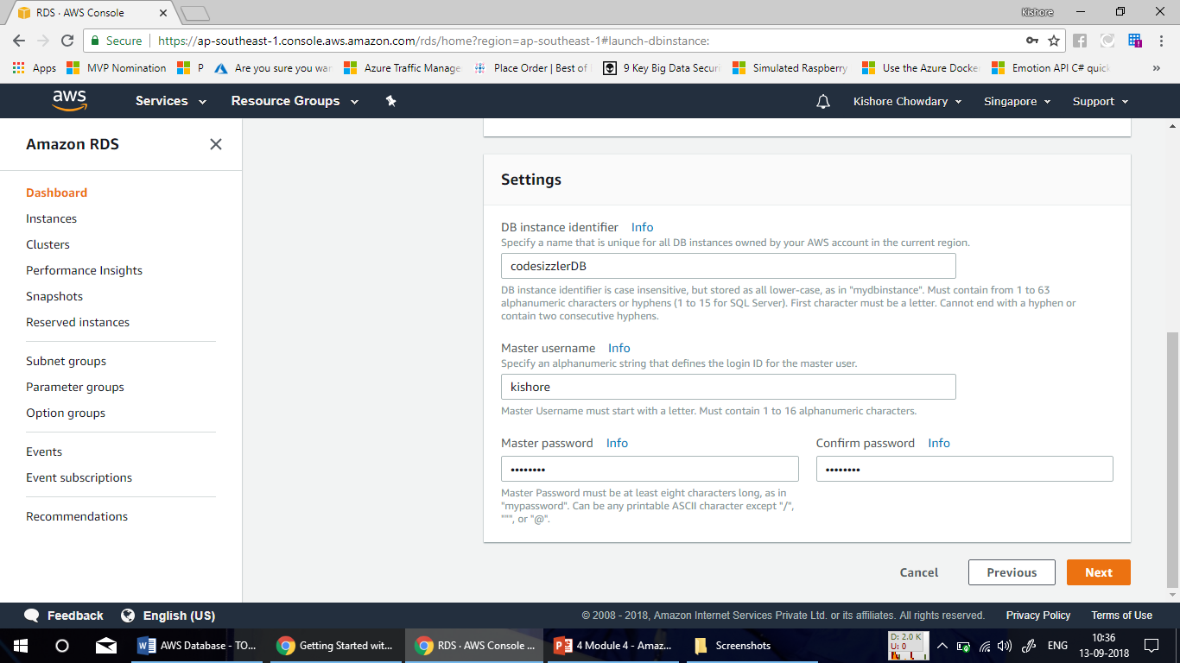

Slide 43
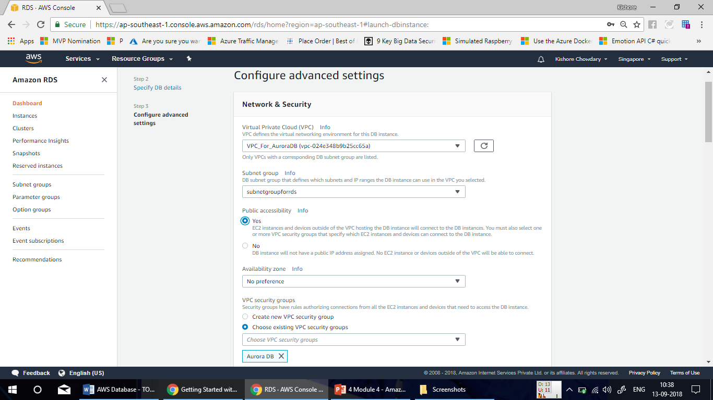

Slide 44
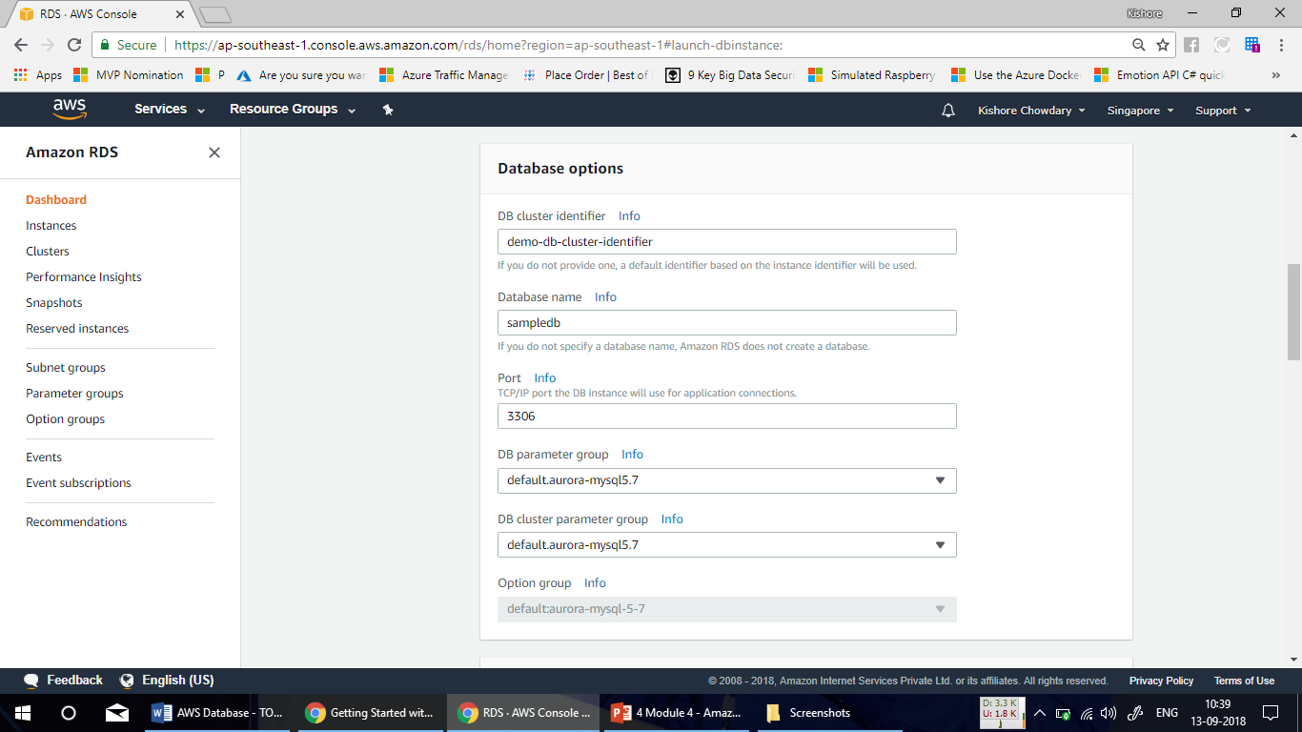

Slide 45
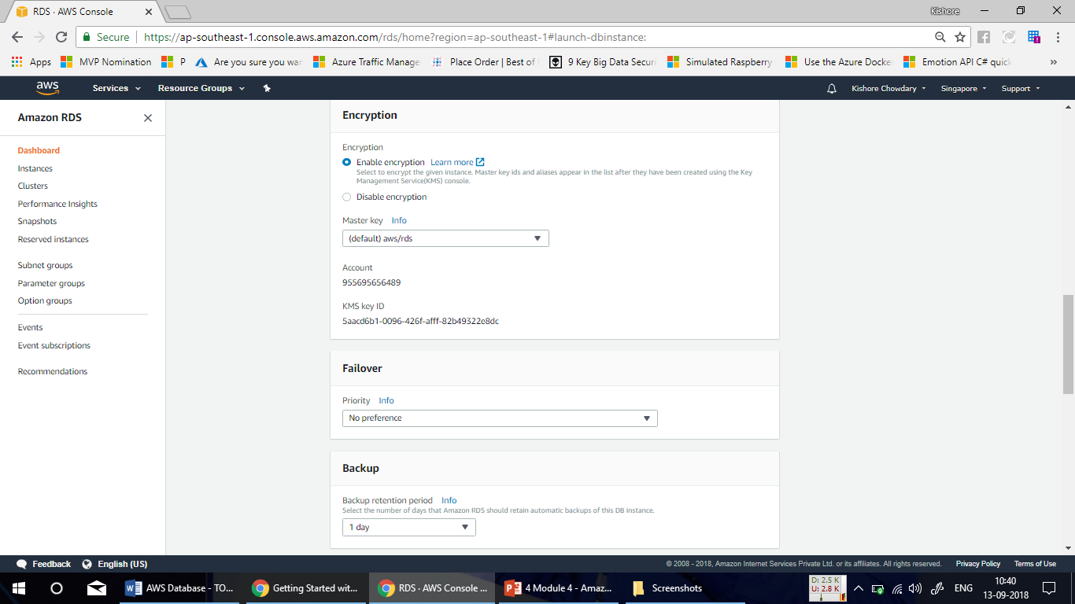

Slide 46
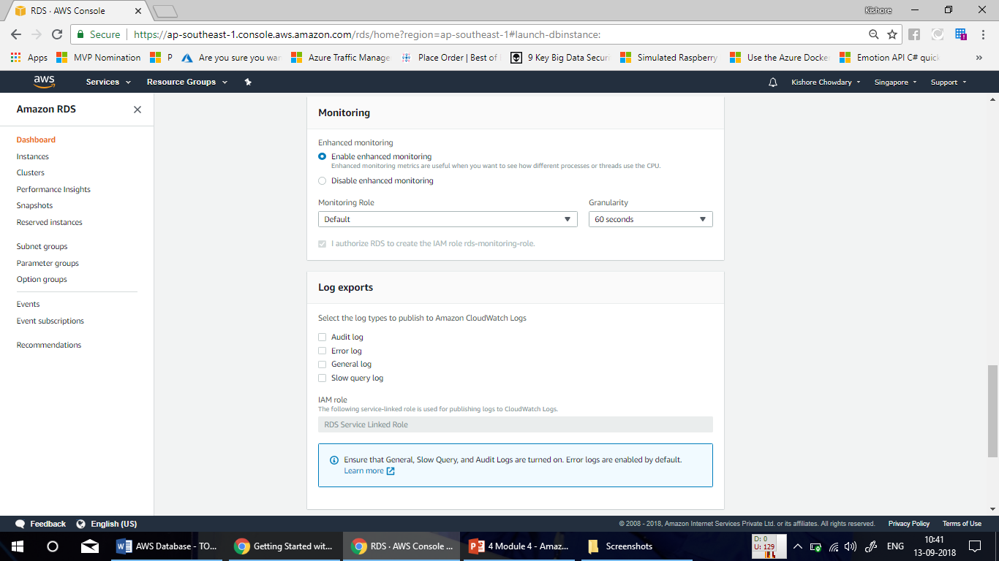

Slide 47
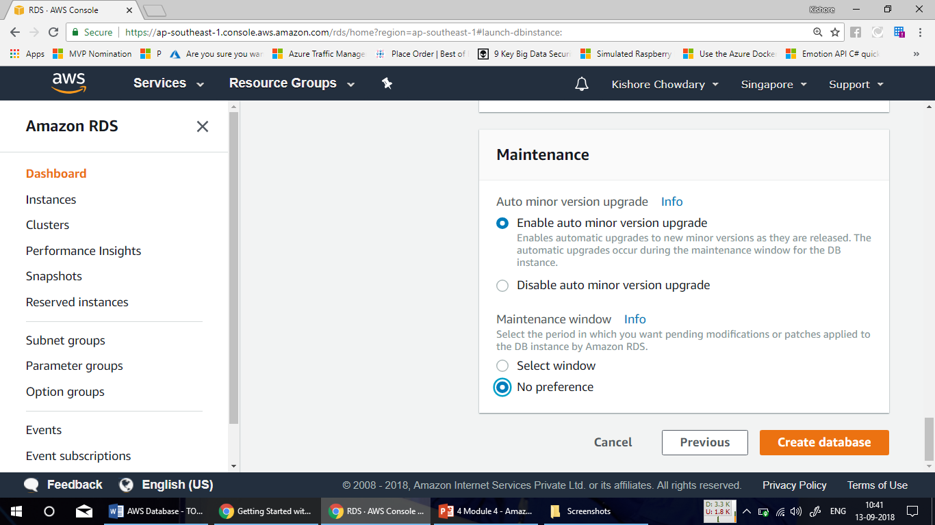

Slide 48
Demo – Connecting to a Database using MySQL WorkBench

Slide 49
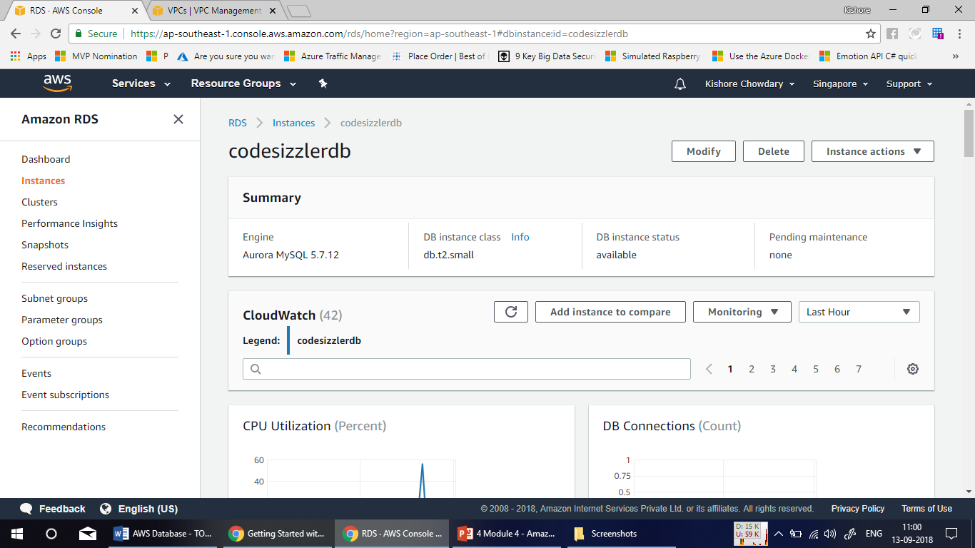

Slide 50
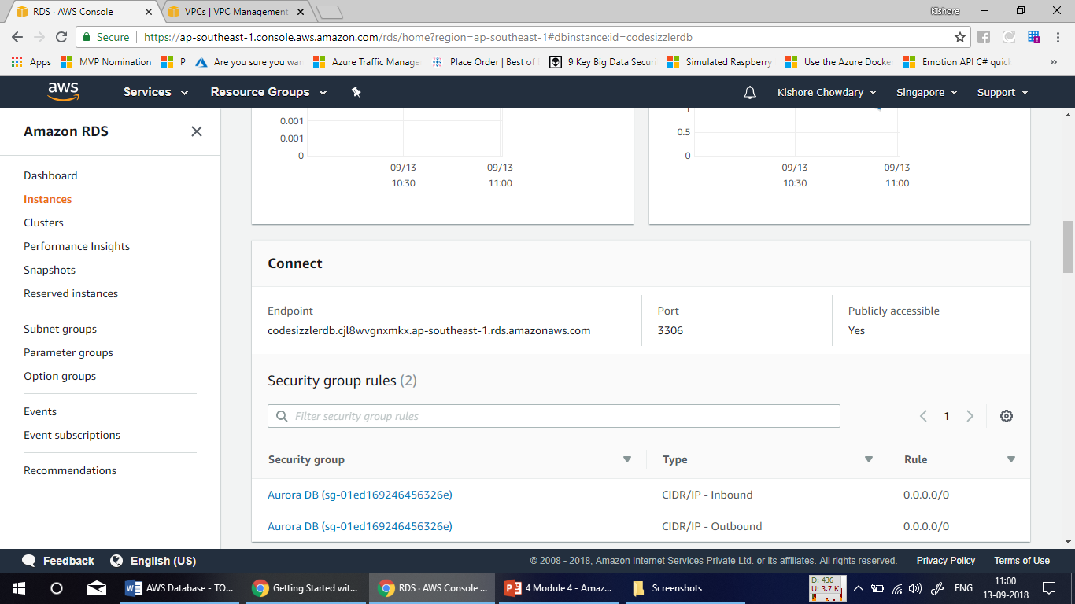

Slide 51
My SQL Workbench
Download My SQL Workbench setup from the following link.
https://dev.mysql.com/downloads/workbench/

Slide 53
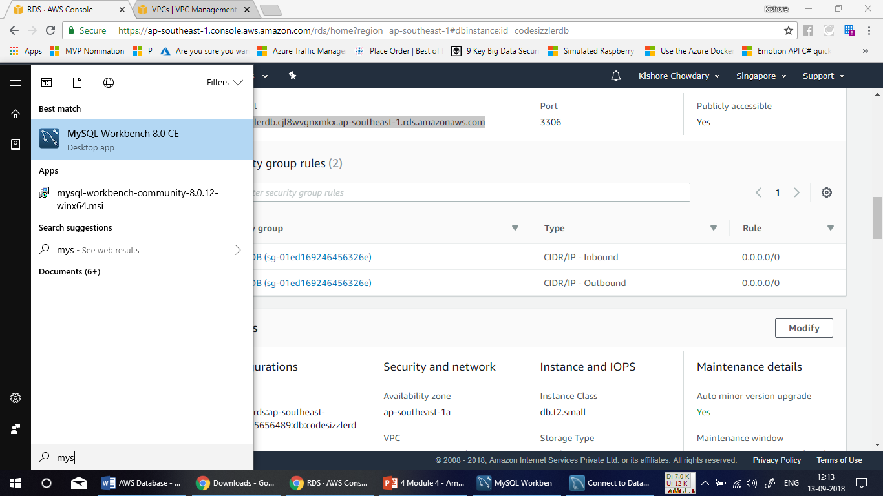

Slide 54
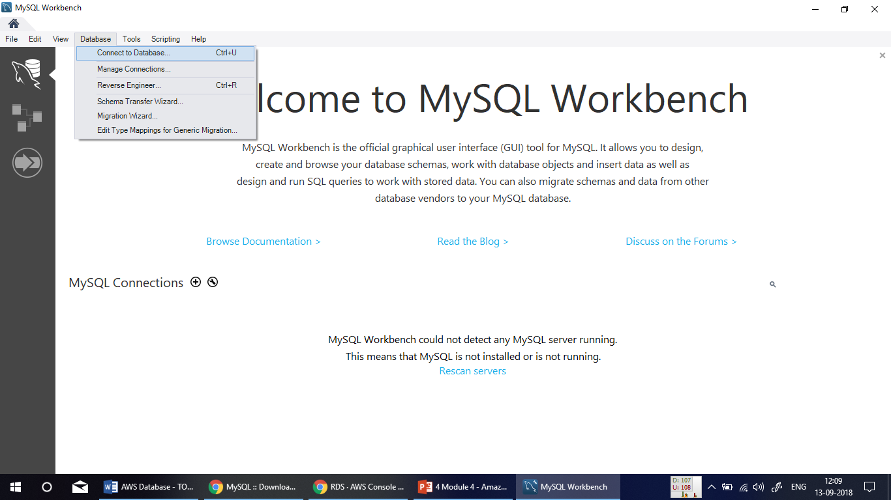

Slide 55
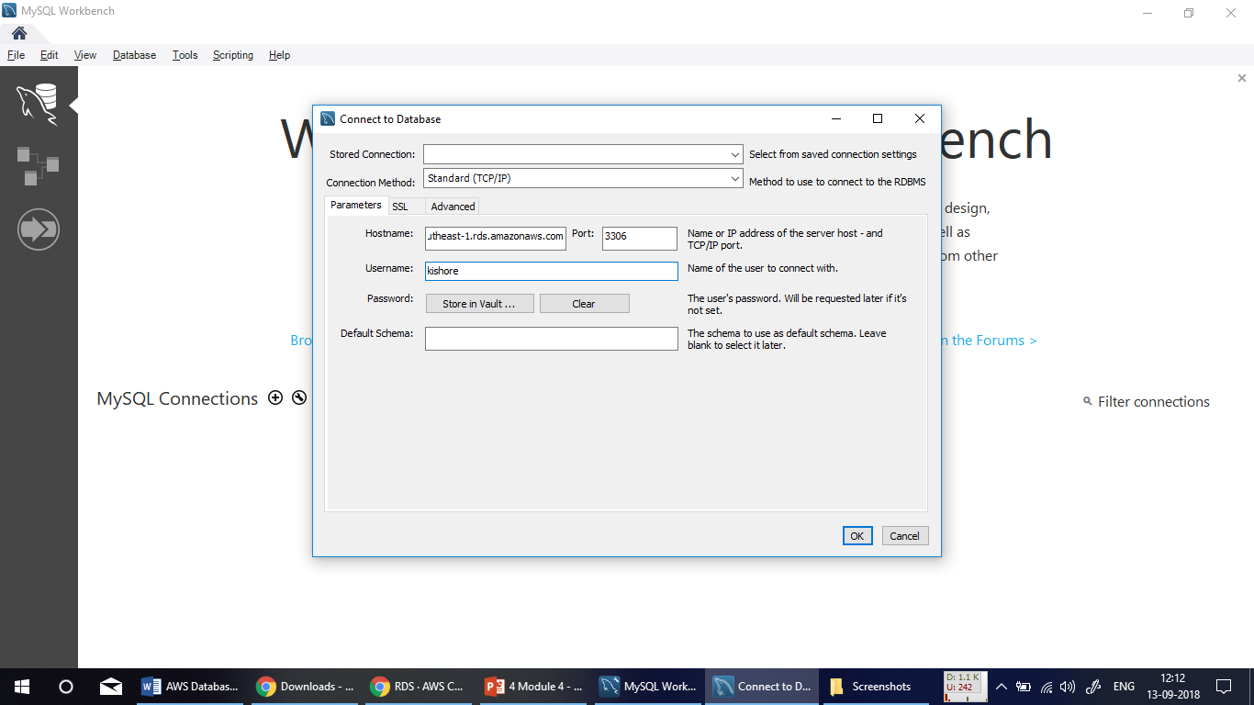

Slide 56
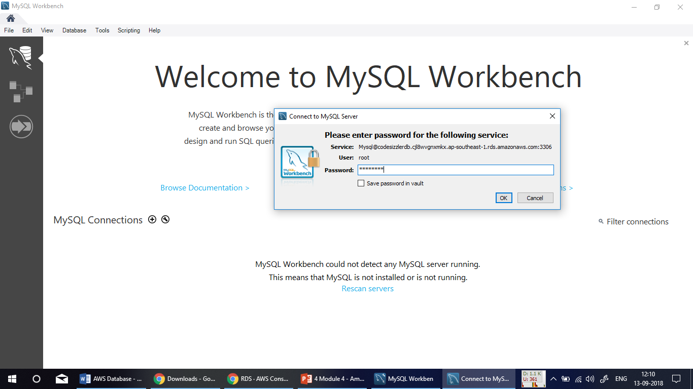

Slide 57
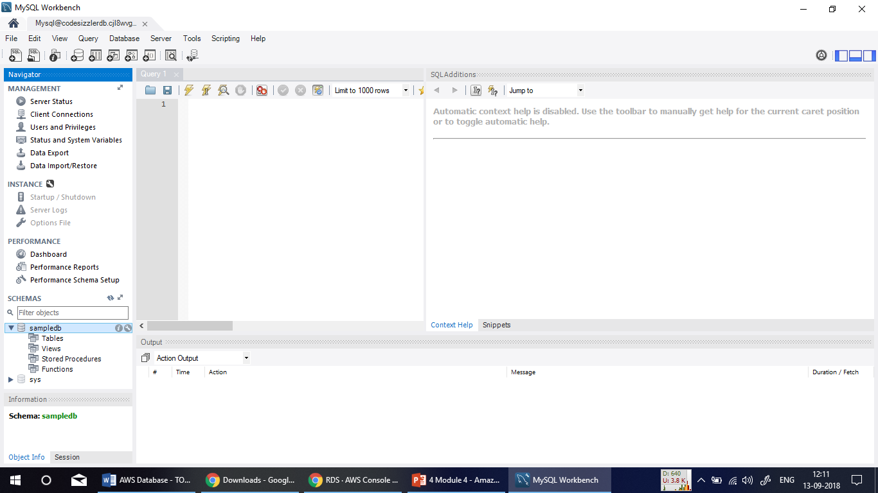

Slide 58
Choosing the DB Instance Class
The DB instance class determines the computation and memory capacity of an Amazon RDS DB instance. The DB instance class you need depends on your processing power and memory requirements.
For more information about instance class pricing, see Amazon RDS Pricing.
Amazon Aurora supports two types of instance classes:
Memory Optimized
Burstable Performance

Slide 59
Instance Class | vCPU¹ | ECU² | Memory³(GiB) | VPC Only⁴ | EBS Optimized⁵ | Max. Bandwidth⁶(Mbps) | Network Performance⁷ | Aurora MySQL | Aurora PostgreSQL
db.r4 – Latest Generation Memory Optimized Instance Classes
db.r4.16xlarge | 64 | 195 | 488 | Yes | Yes | 14,000 | 25 Gbps | 1.15 and later | Yes
db.r4.8xlarge | 32 | 99 | 244 | Yes | Yes | 7,000 | 10 Gbps | 1.15 and later | Yes
db.r4.4xlarge | 16 | 53 | 122 | Yes | Yes | 3,500 | Up to 10 Gbps | 1.15 and later | Yes
db.r4.2xlarge | 8 | 27 | 61 | Yes | Yes | 1,750 | Up to 10 Gbps | 1.15 and later | Yes
db.r4.xlarge | 4 | 13.5 | 30.5 | Yes | Yes | 875 | Up to 10 Gbps | 1.15 and later | Yes
db.r4.large | 2 | 7 | 15.25 | Yes | Yes | 437 | Up to 10 Gbps | 1.15 and later | Yes
db.r3 – Current Generation Memory Optimized Instance Classes
db.r3.8xlarge | 32 | 104 | 244 | No | No | — | 10 Gbps | Yes | No
db.r3.4xlarge | 16 | 52 | 122 | No | Yes | 2,000 | High | Yes | No
db.r3.2xlarge | 8 | 26 | 61 | No | Yes | 1,000 | High | Yes | No
db.r3.xlarge | 4 | 13 | 30.5 | No | Yes | 500 | Moderate | Yes | No
db.r3.large | 2 | 6.5 | 15.25 | No | No | — | Moderate | Yes | No
db.t2 – Current Generation Burstable Performance Instance Classes
db.t2.2xlarge | 8 | 8 | 32 | Yes | No | — | Moderate | No | No
db.t2.xlarge | 4 | 4 | 16 | Yes | No | — | Moderate | No | No
db.t2.large | 2 | 2 | 8 | Yes | No | — | Moderate | No | No
db.t2.medium | 2 | 2 | 4 | Yes | No | — | Moderate | Yes | No
db.t2.small | 1 | 1 | 2 | Yes | No | — | Low | Yes | No
db.t2.micro | 1 | 1 | 1 | Yes | No | — | Low | No | No

Slide 60
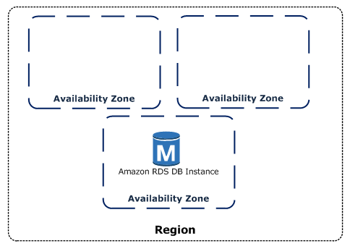
Choosing the Regions and Availability Zones
Amazon cloud computing resources are hosted in multiple locations world-wide. These locations are composed of AWS Regions and Availability Zones. Each AWS Region is a separate geographic area. Each AWS Region has multiple, isolated locations known as Availability Zones.

Slide 61
Adding Aurora Replicas to a DB Cluster
In an Aurora DB clusters, there is one primary DB instance and up to 15 Aurora Replicas. The primary DB instance supports read and write operations, and performs all of the data modifications to the cluster volume. Aurora Replicas connect to the same storage volume as the primary DB instance and support only read operations. Aurora Replicas can offload read workloads from the primary DB instance.

Slide 62
Demo – Adding Aurora Replica to DB Cluster

Slide 63
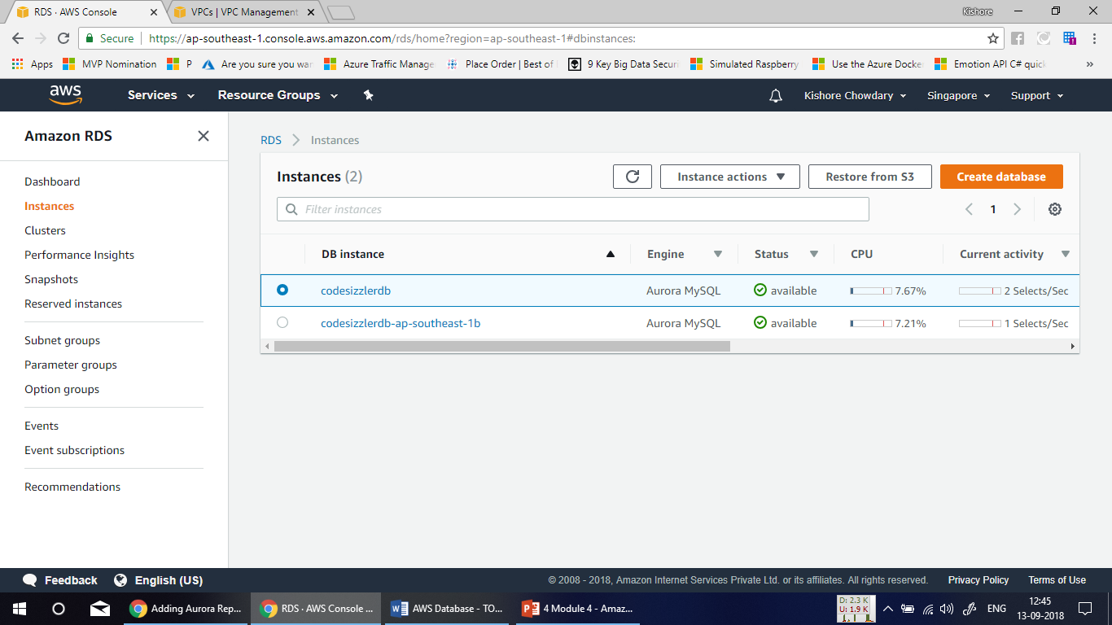

Slide 64
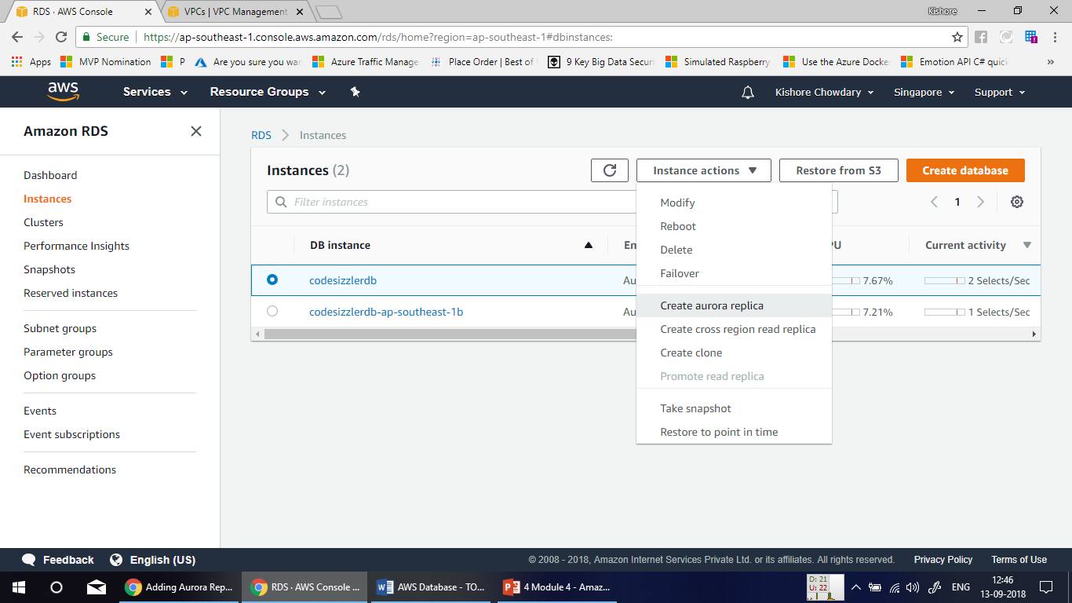

Slide 65
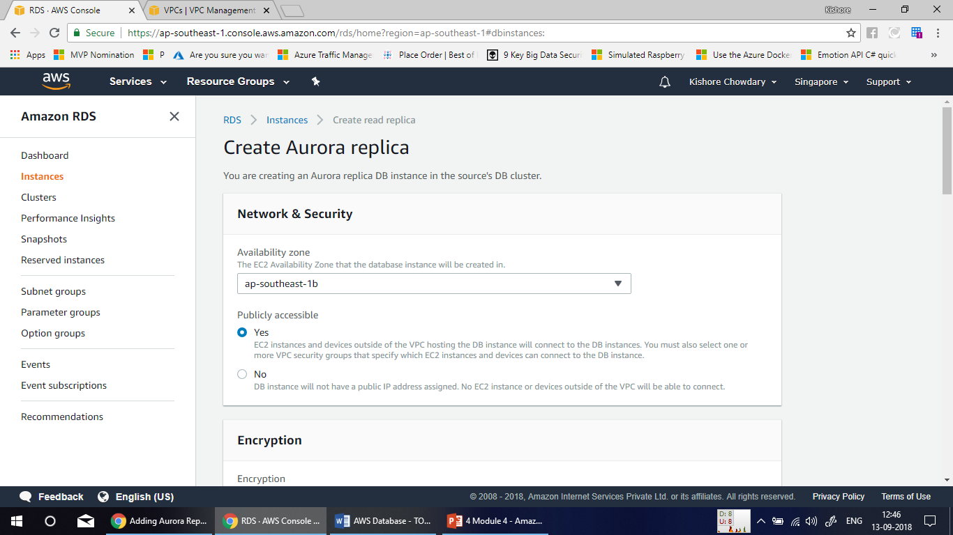

Slide 66
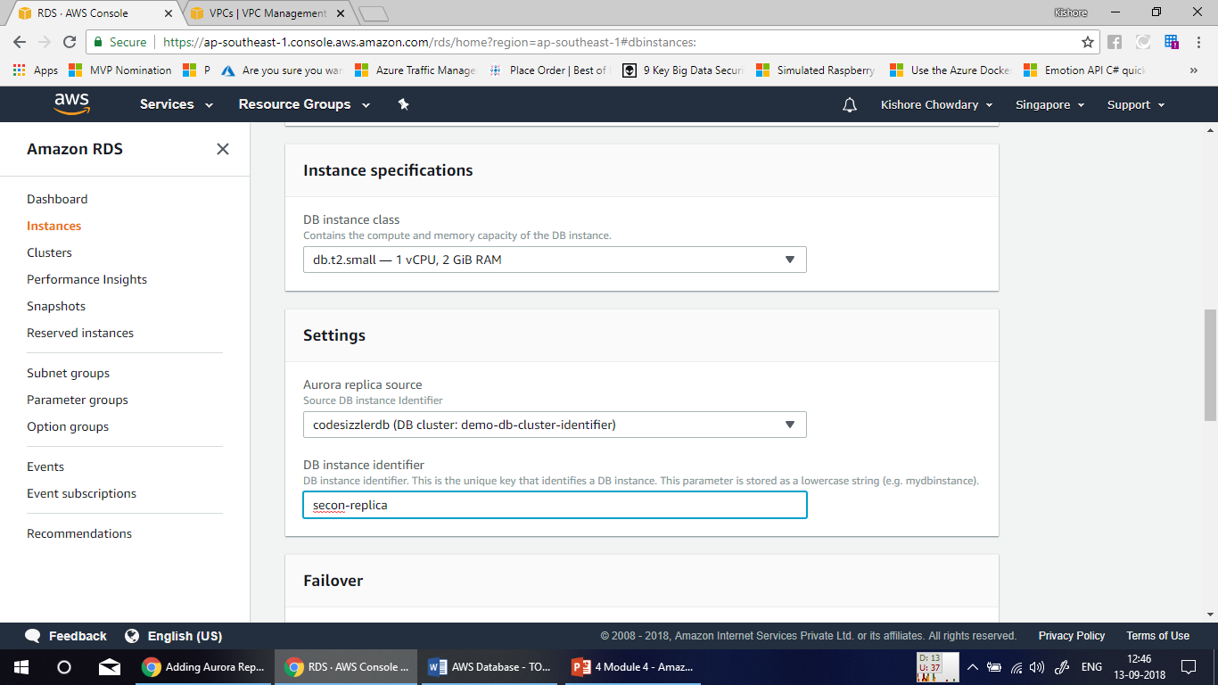

Slide 67
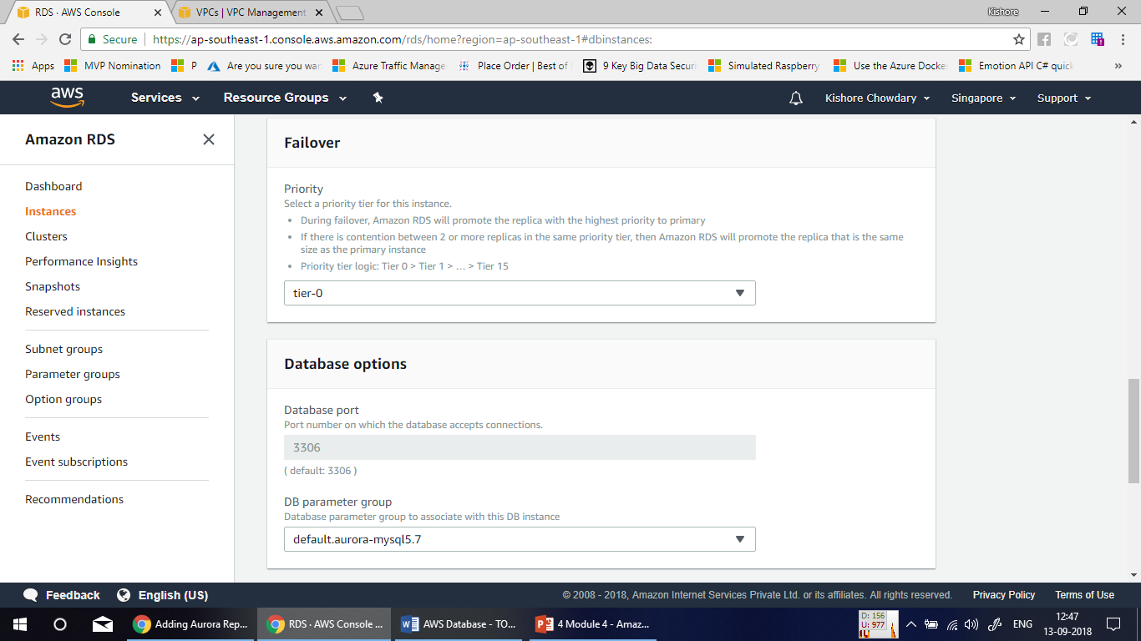

Slide 68
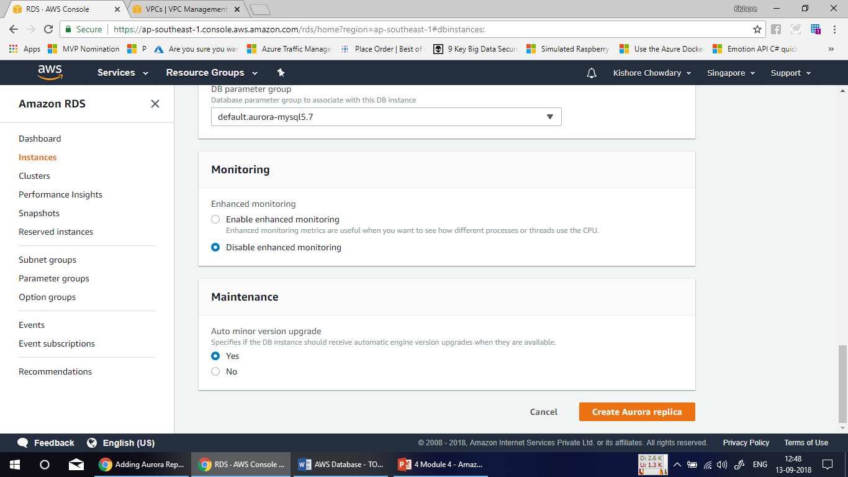

Slide 69
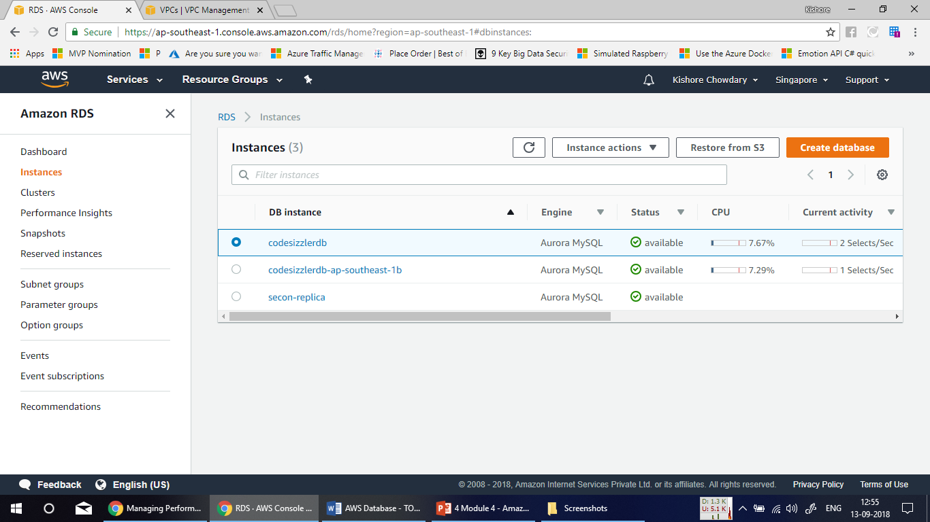

Slide 70
Demo – Performing Failover Event

Slide 71
Managing Performance and Scaling for Aurora DB Clusters
You can use the following options to manage performance and scaling for Aurora DB clusters and DB instances:
Storage Scaling
Instance Scaling
Read Scaling
Managing Connections

Slide 72
Using Amazon Aurora Auto Scaling with Aurora Replicas
To meet your connectivity and workload requirements, Aurora Auto Scaling dynamically adjusts the number of Aurora Replicas provisioned for an Aurora DB cluster. Aurora Auto Scaling enables your Aurora DB cluster to handle sudden increases in connectivity or workload. When the connectivity or workload decreases, Aurora Auto Scaling removes unnecessary Aurora Replicas so that you don't pay for unused provisioned DB instances.

Slide 73
Aurora Auto Scaling Policies
Aurora Auto Scaling uses a scaling policy to adjust the number of Aurora Replicas in an Aurora DB cluster. Aurora Auto Scaling has the following components:
A service-linked role
A target metric
Minimum and maximum capacity
A cooldown period

Slide 74
Demo – Implementing Autoscaling Policy

Slide 75


Slide 76


Slide 77


Slide 78
Backing Up and Restoring an Amazon Aurora DB Cluster
Fault Tolerance for an Aurora DB Cluster
Backups
Restoring Data
Database Cloning for Aurora

Slide 79
Restoring a DB Cluster to a Specified Time
You can restore a DB cluster to a specific point in time, creating a new DB cluster. When you restore a DB cluster to a point in time, the default DB security group is applied to the new DBcluster. If you need custom DB security groups applied to your DB cluster, you must apply them explicitly using the AWS Management Console, the AWS CLI modify-db-cluster command, or the Amazon RDS API ModifyDBCluster action after the DB instance is available

Slide 80
Demo – Point in Time Recovery

Slide 81


Slide 82


Slide 83


Slide 84


Slide 85


Slide 86
Summary
Compatibility with Database Engines
Storage Auto-Scaling
Low latency read replicas
Auto Fail Over Grouping
Backup and Point-in-time Recovery
HA Across Availability Zones
Aurora DB for heavy write traffic

Slide 87

Thank You!

